Slide 1
Watch It
Logon to google classroom
Click on the assignment “Understanding Interest Groups”
Using your headphones, Watch the Crash Course Videos and answer the accompanying questions.

Slide 2
Running & Funding Campaign
3.6Identify how interest groups (lobbying) influence law making and voter bias

Slide 3
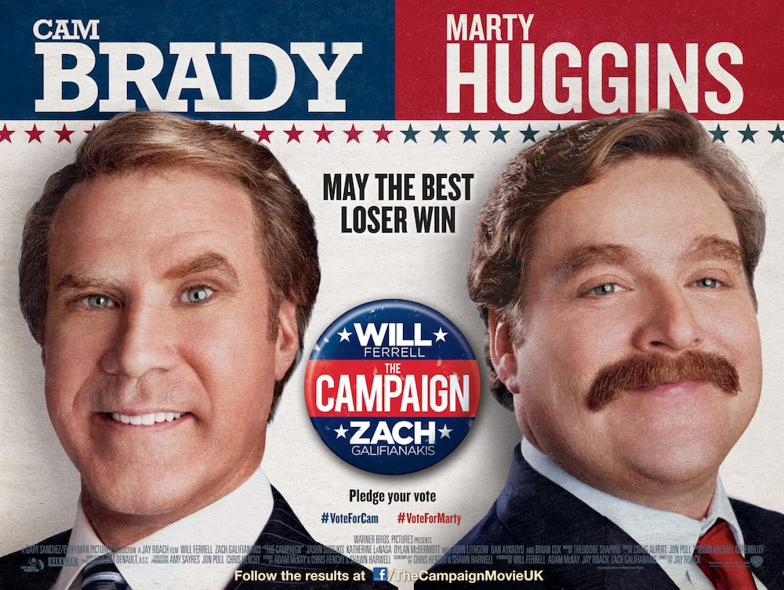
The Campaign
A Political Campaign in Labor Intensive & Media Driven
Canvassing – when candidates/volunteers travel through neighborhoods asking for votes or take opinion polls

Slide 4
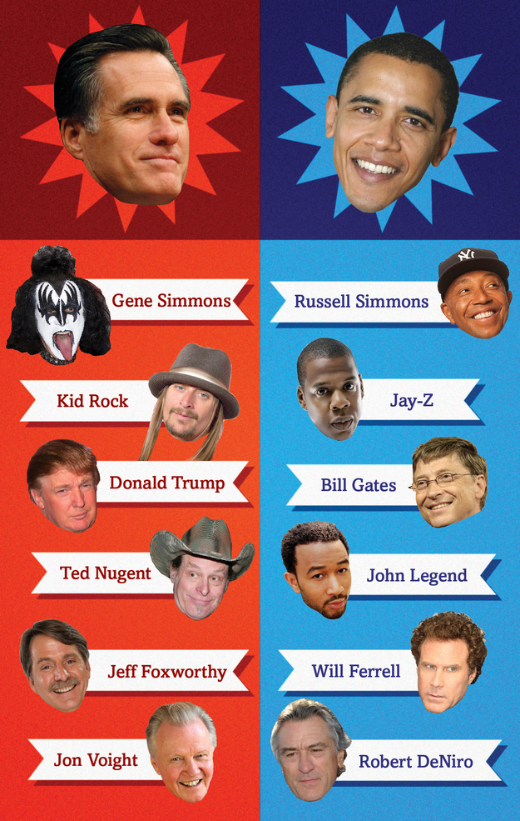
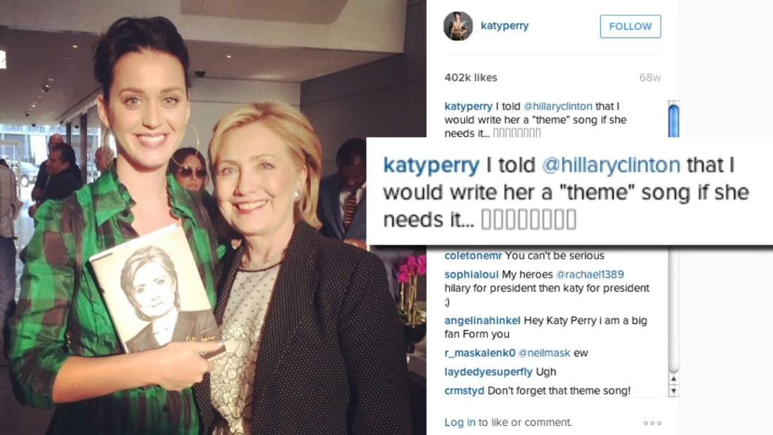
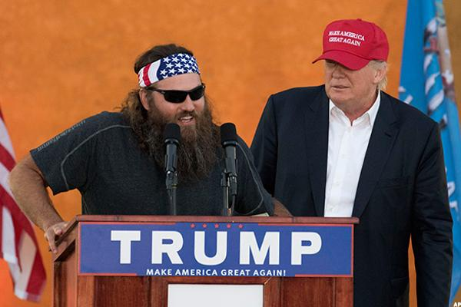
Propaganda - attempt to promote a particular person or idea
Endorsements – when a famous/popular person campaigns for a candidate

Slide 5
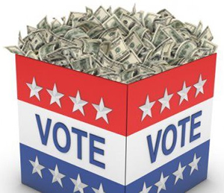
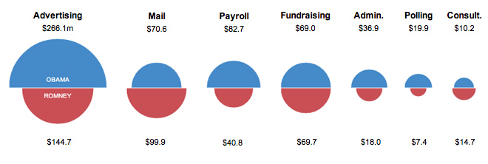
Fundraising
Keep in mind you can donate during Primaries and the GE so an individual can donate a max of $5400
Private Funds – money from individual contributors, large corporations or fundraisers
Limit of $2700 per person
Can fund your own campaign w/o limit
Public Funds – federal gov’t matches funds raised up to $10 million

Slide 6
Other Funds
Interest Groups – individuals who share a point of view about an issue unite to promote their beliefs
Work to persuade law makers and public officials to support actions that help their cause
Also try to influence elections by educating the general public about their views.

Slide 7
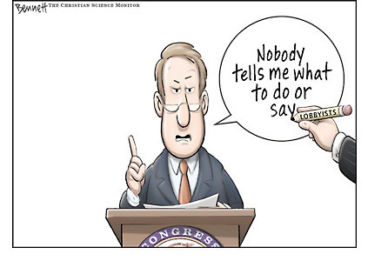
Conflict of interest?
What is this cartoon suggesting?

Slide 8
Types of Interest Groups
Economic: represent economic issues such as big business, oil industry, auto industry,
Non-Economic: social issues such as education, race or ethnicity issues, gender equality, environment, etc.

Slide 9
Major Interest Groups
NRA– National Rifle Association
NAACP– National Association for the Advancement of Colored People
NOW– National Organization of Women
Sierra Club– environmental issues
AARP– retired people
AMA– American Medical Association

Slide 10
Examples
The National Rifle Association (NRA) – works to preserve law-abiding citizens’ right to buy, have and use firearms for legitimate purposes.
The Brady Campaign – works to prevent gun violence. Responsible for passing the Brady Bill in 1993, which required a 5-day waiting period and background check before someone can buy a handgun

Slide 11
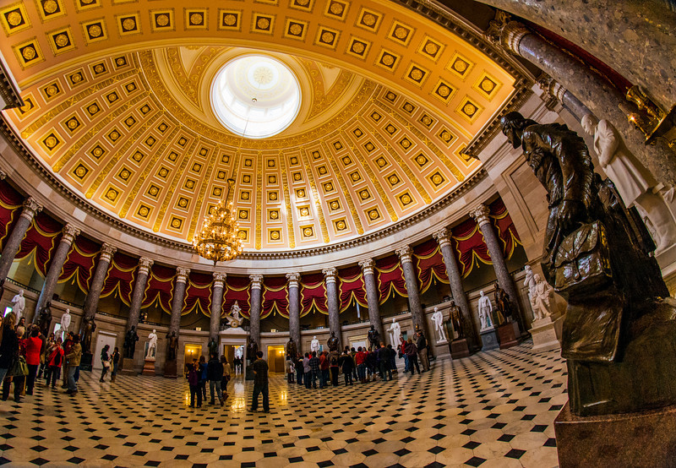
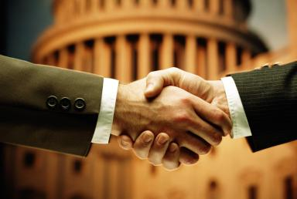
Strategies
To impact lawmaking…
Hire Lobbyists – representatives of interest groups who contact lawmakers or other government officials directly
Their job is to provide information to lawmakers
The goal is for the lawmaker to pass a bill that favors their cause

Slide 12
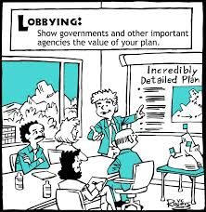
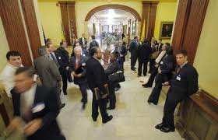
Strategies
To impact elections..
IGs will endorse a candidate.
They choose candidates they believe will help their cause
The IG encourages its members to vote for that person, and run advertisements to persuade others to vote for them

Slide 13
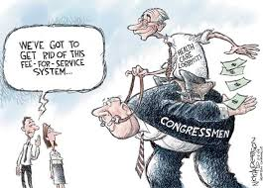
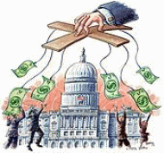
Strategies
Donating to Candidates…
IGs donate money to political campaigns in exchange for support from the candidate
Can anyone see a potential problem with this?
There are strict rules about how IGs may collect and donate money

Slide 14
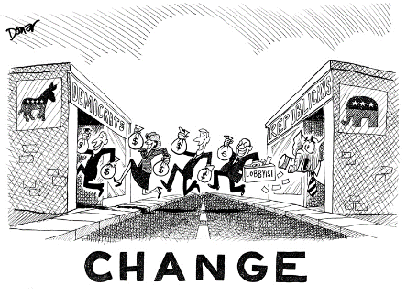
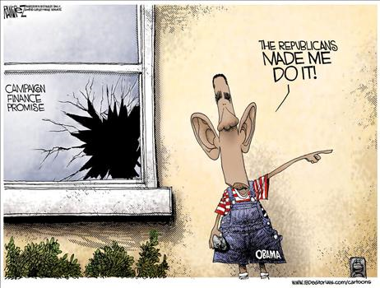
Donating Money
To donate $ an IG must form a PAC (Political Action Committee) – organization set up to collect money for a specific candidate (up to $5000)
Because there are so many restrictions on PACs and Private Funding, Congress allows political parties to raise…
soft money - unlimited money for general party purposes, cannot go to a particular candidate

