Slide 1
Welcome Knight Time!
Find a seat and settle in
18 school days left…are you ready for our final???

Slide 2
Welcome C&E Students!
Find your seat and settle in
Roll Call: Spaghetti, Ravioli or Lasagna?
Bell Work
Take out a chromebook
Got to google classroom
Click on the “Crash Course” assignment
Watch the video and answer the accompanying questions regarding economies
Turn it in when finished

Slide 3
Reminders
Parts 11-13 of Budget Project past due
Part 14 due tomorrow night
If there are any outstanding BP assignments you will work on them in the MC in instead of Monopoly
Monopoly tomorrow and Wednesday
Recovery
Unit 5 – Participation

Slide 4
7.1 Types of Economies
Identify the 4 types of economies

Slide 5
3 economic questions
What to produce?
How to produce it?
For whom to produce it?

Slide 6
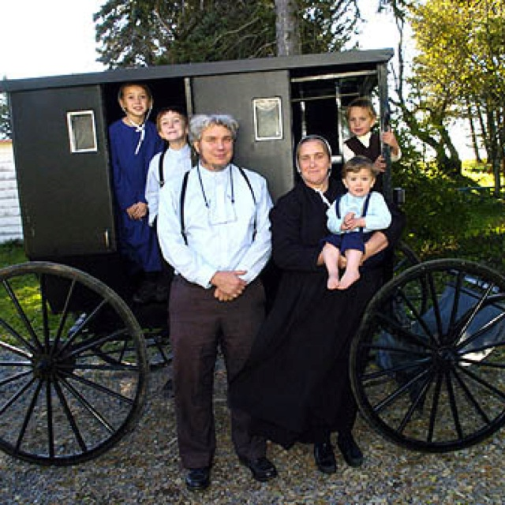
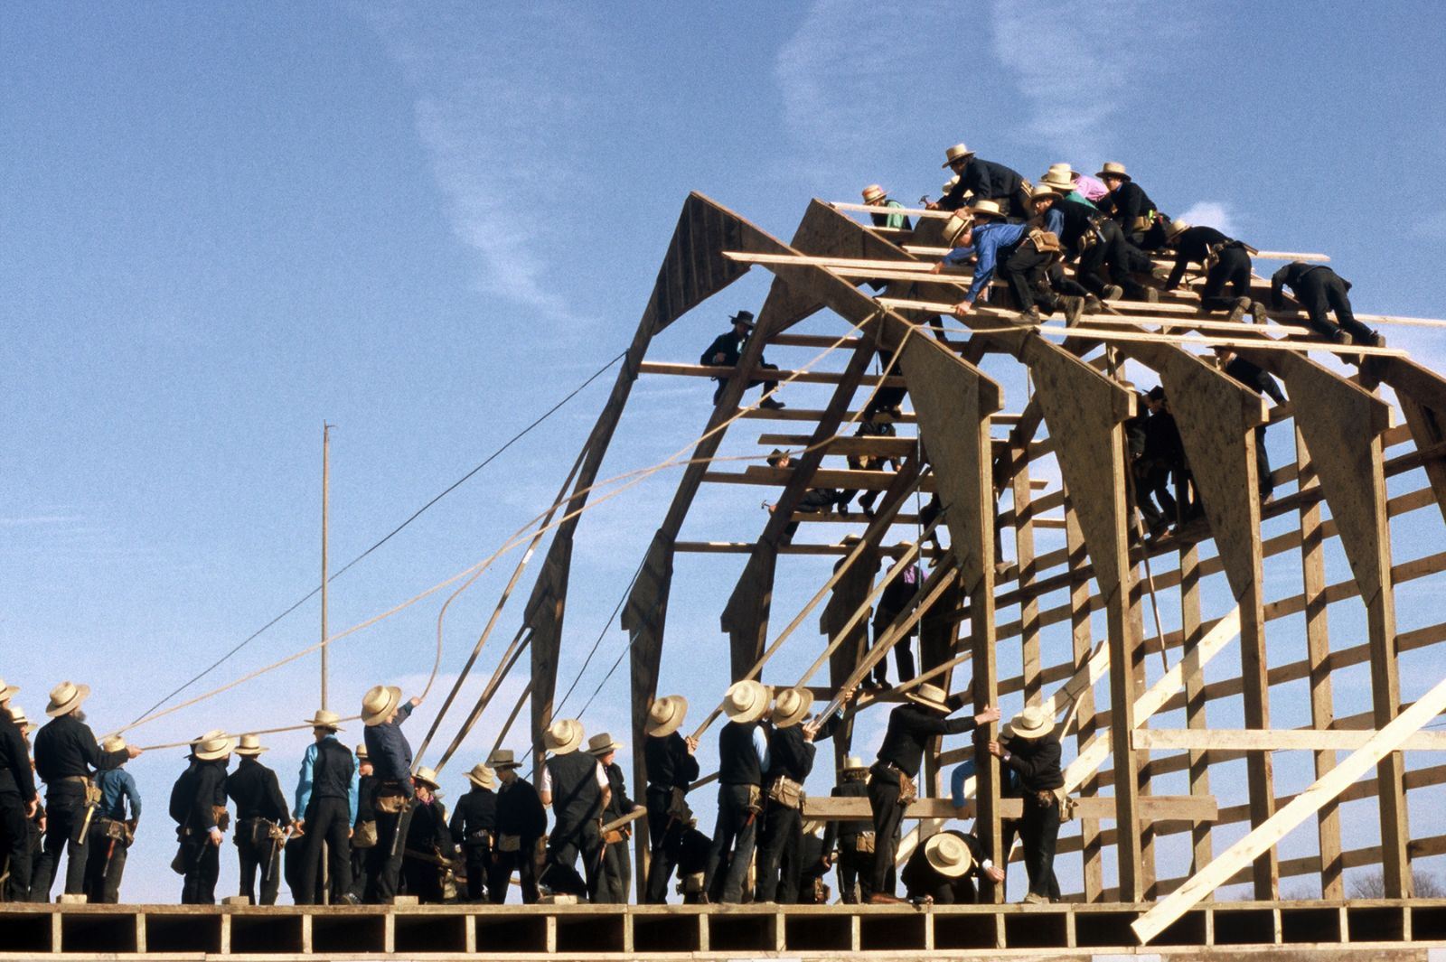
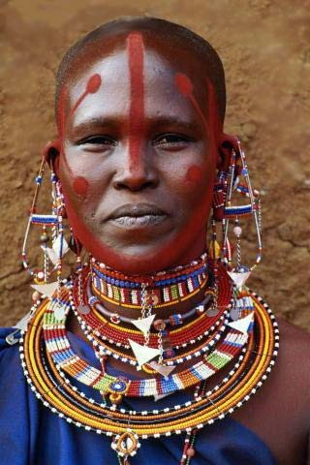
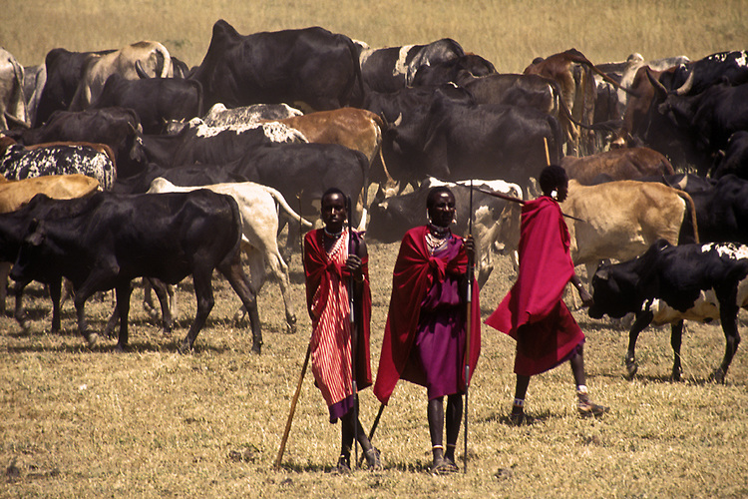
Traditional economies
Definition
Relies on habit and custom
Barter and Trade
Examples:
Amish
Massai

Slide 7
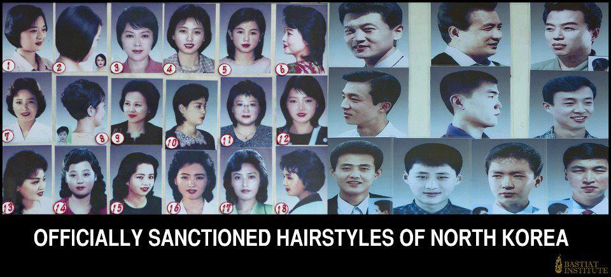
Command/ Centrally Planned Economy (Communism)
Definition
government makes all economic decisions and owns all factors of production
Examples
Cuba, North Korea, China, 1920-1991 Soviet Union

Slide 8
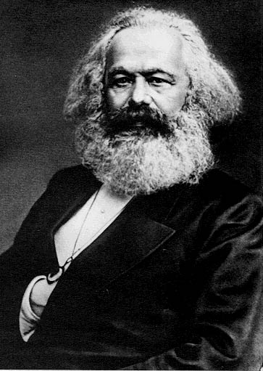
Karl Marx’s “Communist Manifesto” (1848)
Father of Communism
believed all politics and history is driven by the struggle of the proletariat (working lower class) vs. the bourgeoisie (rich upper class)
Advocate for the worker
believed a societal change can only come after a violent revolution

Slide 9
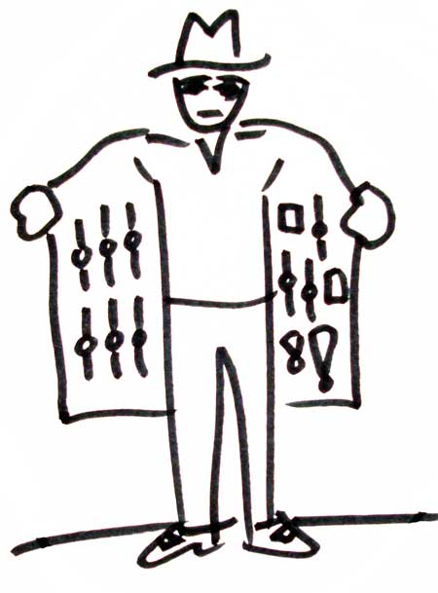
Free Market Economy (Capitalism)
Definition
economic decisions are made solely by people
Example of this type of economy
No modern example (US still has gov’t intervention)
Black Market

Slide 10
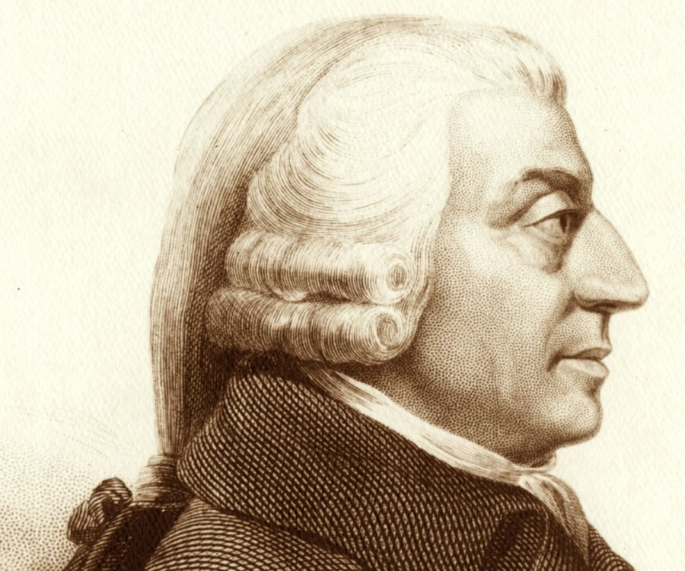
Adam Smith’s “Wealth of Nations” (1776)
Father of Capitalism
laissez-faire – gov’t leaves businesses alone; hands off
free enterprise - few government restrictions
Competition and Self-Interest regulate the economy; prices lower and quality increases
“The Invisible Hand” – supply and demand will take care of the economy

Slide 11
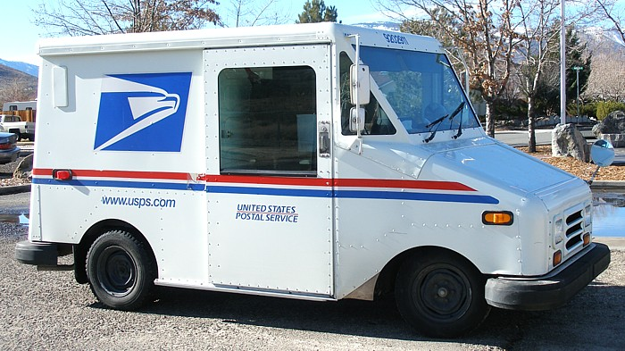
Mixed Economy (Communism + Capitalism)
Definition
Mixture of private and public ownership
Regulations (FCC, FDA)
Subsidies
Example of this type of economy
US, France, UK, Canada
Socialism

Slide 12
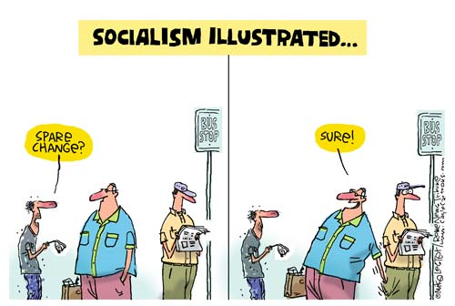
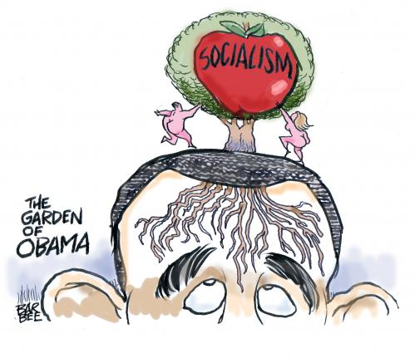
Socialism
philosophy that wealth should be redistributed throughout society and everyone has a role to fulfill within the economy
can allow for a mix of private and public ownership
in socialist countries, gov’t often owns most major industries and uses wealth for social programs

Slide 13
Three Economic Questions
Test your knowledge of the 3 economic questions and the four types of economies
Read the question
Determine which of the 4 options represents Traditional, Command, Free Market or Mixed
Turn in your work to the class tray
Continue working on Budget Project, your warmup video or Final Blueprint

