Slide 1
Create your budget!

Slide 2
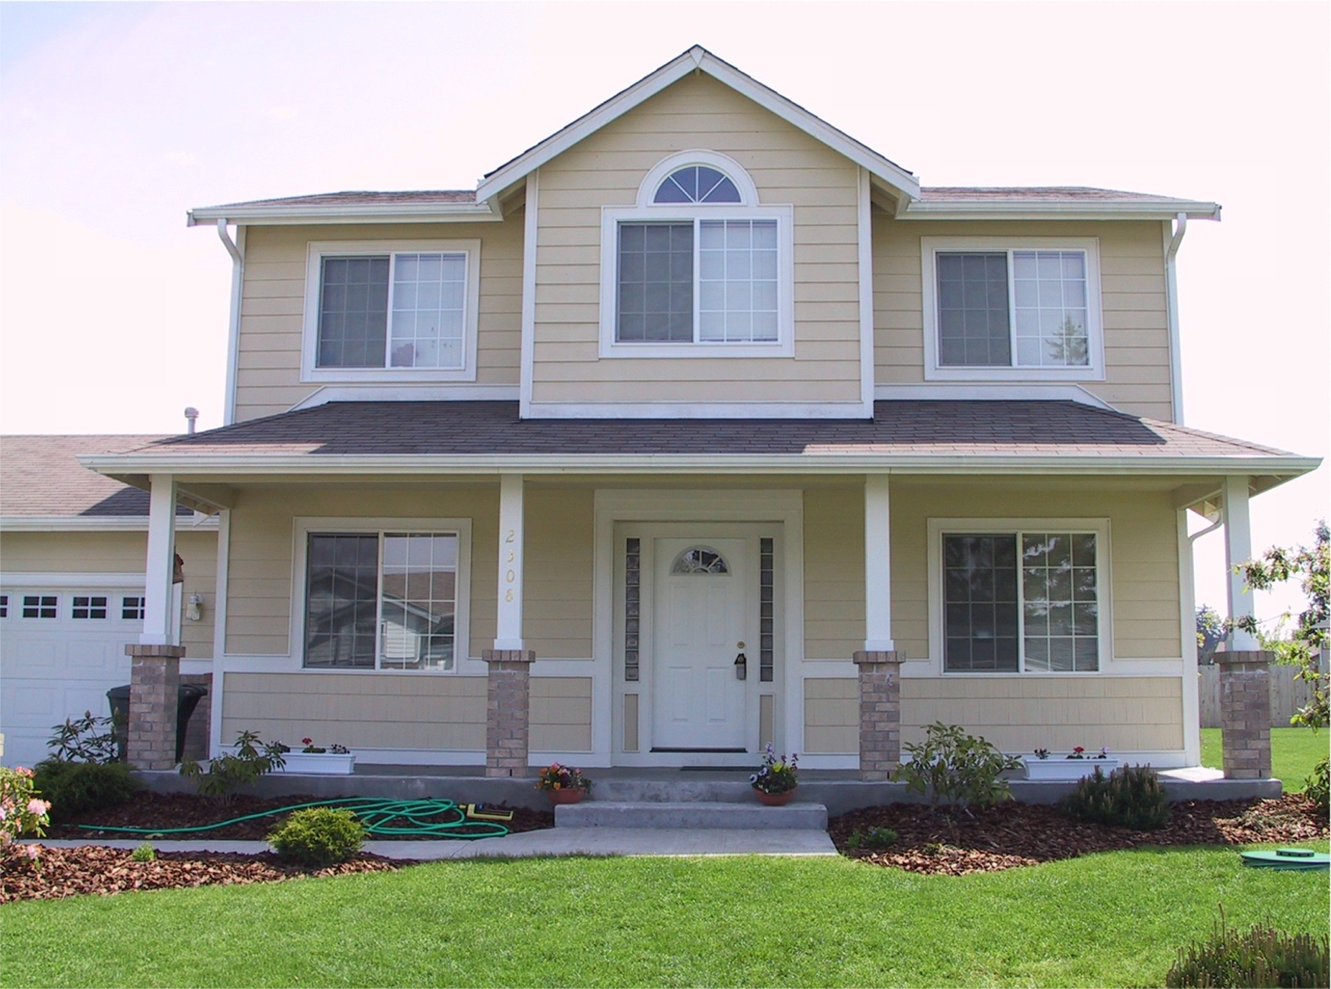
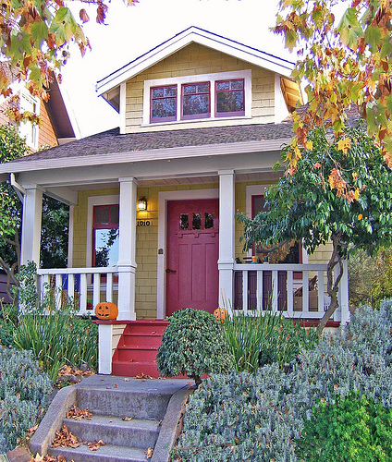
Housing
The Average House (own)
-$800/month
-$180 (water/electric/gas)/month
The Smaller House (own)
-$650/month
-$120 (water/electric/gas)/month

Slide 3
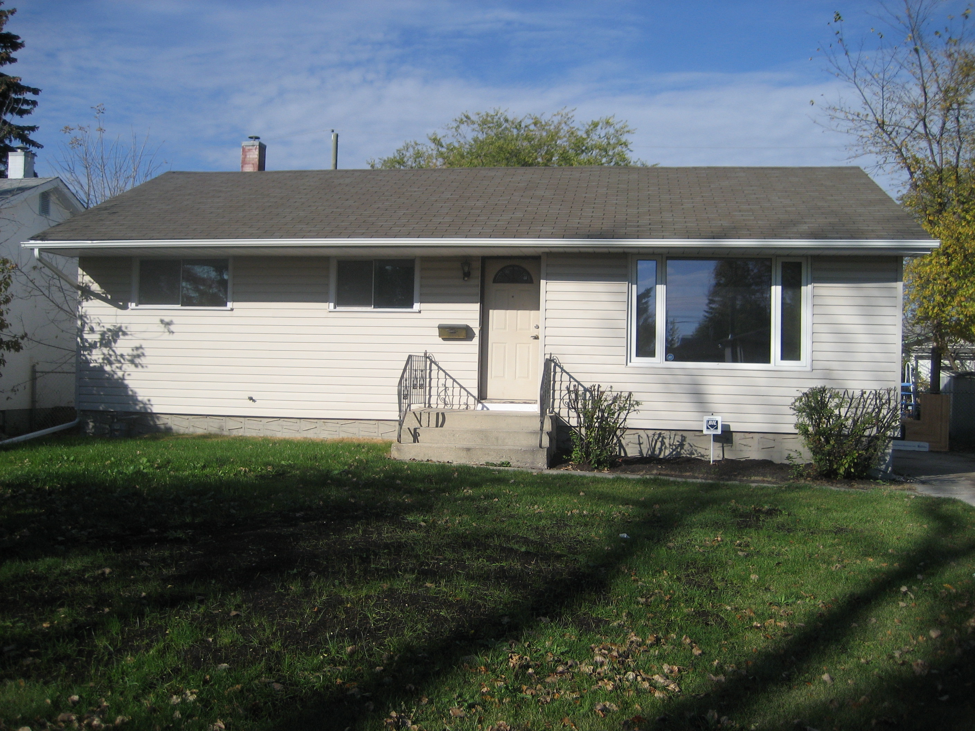
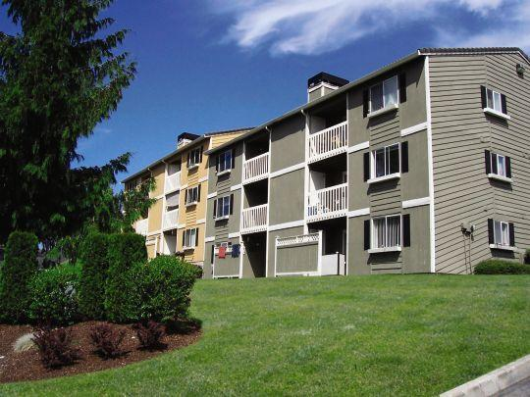
Housing
The Rental House (rent)
-$550/month
-$100 (water/electric/gas)/month
The Apartment (rent)
-$530/month
--water/electric/gas included

Slide 4
Automobile
The New Beauty (own)
-$450/month
-$90/month insurance
-$250/month gas
The New Economical (own)
-$295/month
-$32/month insurance
-$100/month gas

Slide 5
Automobile
The Used Guy (own)
-$225/month
-$45/month insurance
-$140/month gas
The Lease (not owned)
-$170/month
-$70/month insurance
-$100/month gas

Slide 6
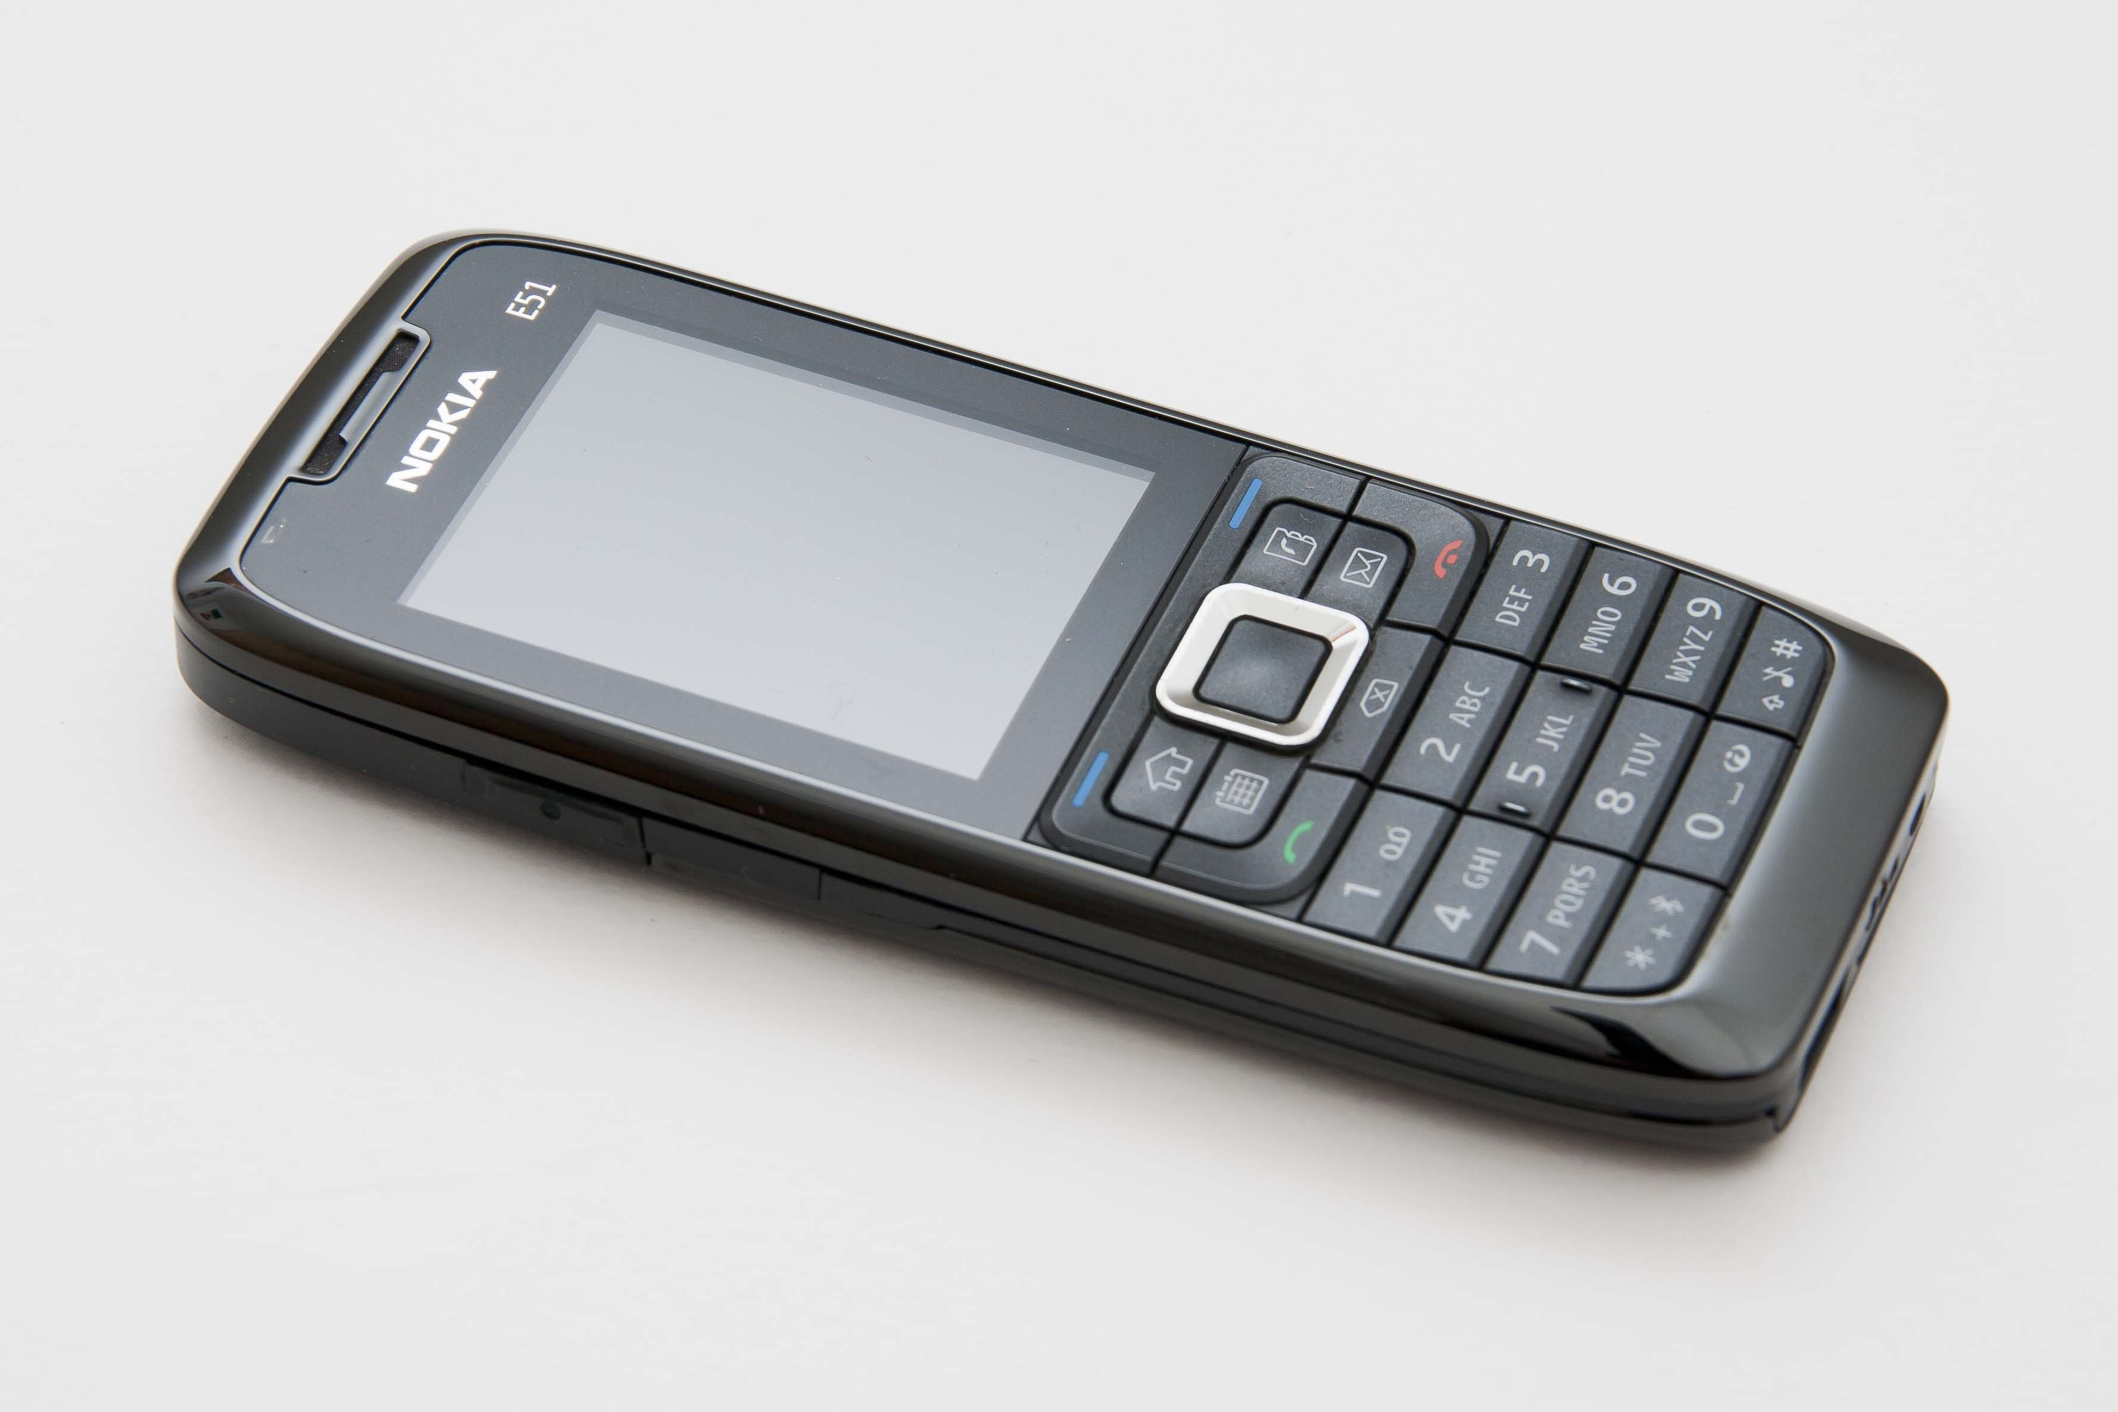
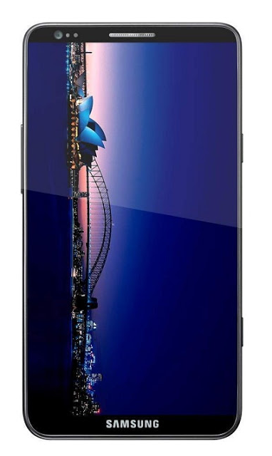
Phone
The Sleek Techie (own)
-$95/month
The Average Joe
-$65/month

Slide 7
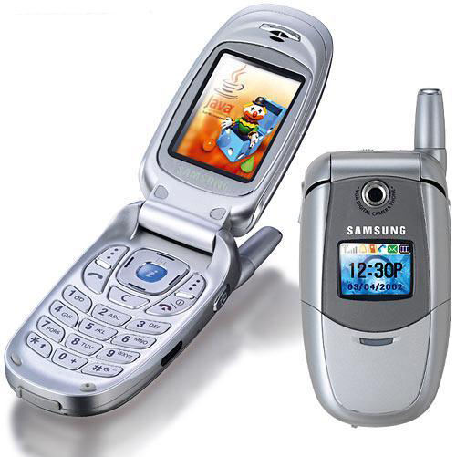
Phone
The Cheapie (own)
-$40/month
The Pay-As-You-Go
-$20/month
-$5/text
-$0.50/minute (outside of $10 free allotted per day)

Slide 8
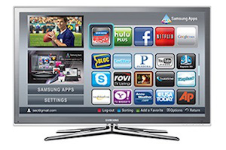
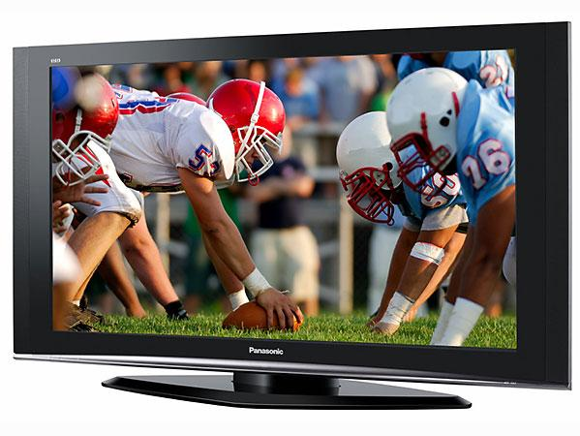
Television and Internet
The Supreme Package
-$158/month
Includes:
-Netflix, 140 cable channels, High-Speed Internet, HBO, SHOWTIME
The Regular
-$92/month
Includes:
-70 cable channels, High-Speed Internet, Netflix

Slide 9
Television and Internet
The Basic
-$30/month
Includes:
-60 cable channels
The Internet Only
-$67/month
Includes:
-High Speed Internet

Slide 10
Groceries
Groceries:
-$250 = eating very well (whatever your heart desires)
-$200 = eating well (protein, some veggies, snack foods)
-$125 = eating to get by (primarily snack foods and store brand stuff)
-$75 = Ramen diet (not healthy)

Slide 11
Other expenses
Other Expenses:
Saving: How much will you set aside to put in your savings?
Household Items: How much will you set aside for your household items (cleaning supplies, toilet paper, laundry detergent, soap, etc.)
Credit Payment: How much do you want to put toward paying off your credit card each month? (minimum $15/month)
Miscellaneous: How much will you set aside for spending on going out to eat, hanging out with friends, buying video games, apps, etc.

