Slide 1
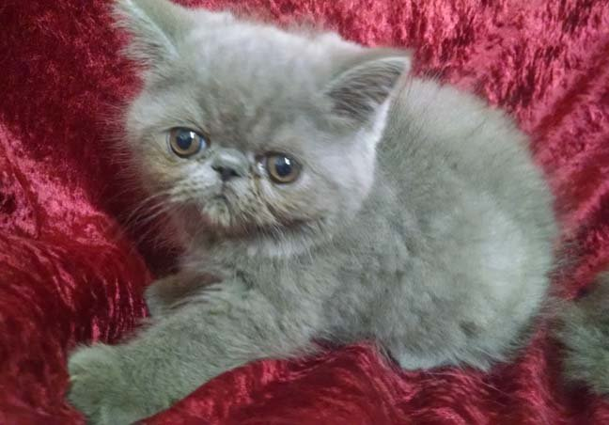
Breaking News!
Meet Fizzgig

Slide 2
Welcome C&E?
Find your seat and settle in
Roll Call: Have you been naughty or nice?
Bell Work: PREPARE FOR YOUR TEST!
Go to the bathroom now
Sharpen your pencils
Login to you chromebook
All belonging will be placed at the front/back of the room

Slide 3
1. Go to socrative.com 2. Click student login 3. Enter Room Name: WINTERBREAK 4. “Wait for the next activity to begin” 5. Once I begin the test, enter your last, first name
TEST YOURSELF!

Slide 4
SHHHHH! Test in Progress!
All you need is a pencil
Belongings should be placed at the front/back of the room
Have a question? Ask A Question!
Raise your hand when you are ready for your Short Answer
Turn in your SA to Ms. Peach when finished and Grab a Final Blueprint (MANDATORY FOR EVERYONE = 200 Informal Points)

Slide 5
Welcome Homeroom!
Find your seat and settle in
Welcome to our Homeroom Holiday Hooray!
Wait for Ms. Peach’s say-so to get your snacks
Thanks to Avanthi, Edison and Jack for bringing in some sweet treats!

Slide 6
Where Were My Clothes Made?
Find a buddy if you need help
Choose one item of clothing and find the label that indicates where it was made.
Be prepared to share.

Slide 7
Welcome C&E Students!
Find a seat and settle in
Roll Call Question: If you could live in another country where would you live?
Bell Work:
1. Draw and label the Business Cycle
2. Provide an example of each phase of the Business Cycle
3. What factors led to the Great Depression? (at least 3)
4. What is speculation? Why would this practice be considered risky?
5. Who controls Fiscal Policy? _______________________ ____________
Who controls Monetary Policy? __________________________________
6. Explain when and why the Fed would use Tight-Money and Loose-Money Policy

Slide 8
Reminders
Unit 7 Test is Tuesday
Quiz on Monday
Role of Money, Business Cycle, Fiscal v. Monetary Policy
Budget Project Past due
Taxes Webquest due last night
Recovery
Final Blueprints are mandatory for EVERYONE!!! Due the day of your final
10 school before exams

Slide 9
Economics 7.5
International Economics
Analyze costs and benefits of global trade

Slide 10
What is Globalization?
People, countries and governments exchanging ideas, products and world views across barriers of distance, culture and technology

Slide 11
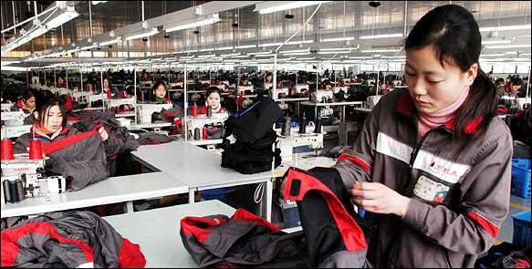
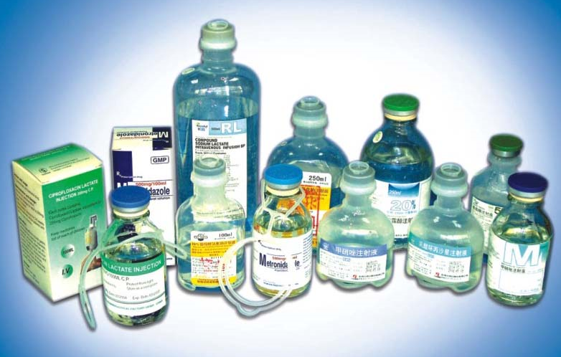
I. Why nations Trade
Comparative advantage
Nations try to produce goods at a lower cost or more efficiently than others
Nations specialize on the goods that they produce the best, trade to get other goods

Slide 12
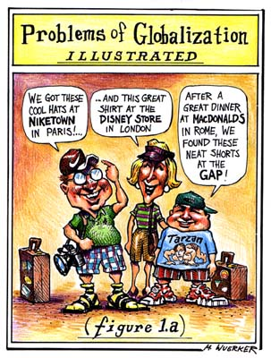
Global interdependence
In our globalized economy, every nation is dependent on the rest
helps increase production among all

Slide 13
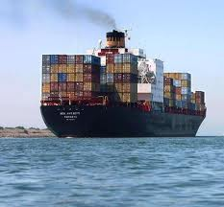
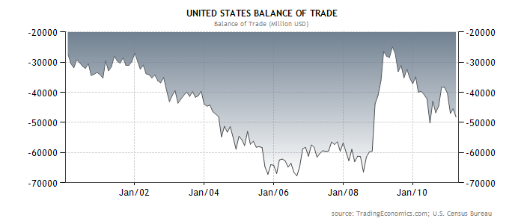
II. Balance of Trade
Balance of Trade- relationship b/w a nation’s imports and exports that affects its currency
Trade Surplus- more exports than imports, leads to a strong currency

Slide 14
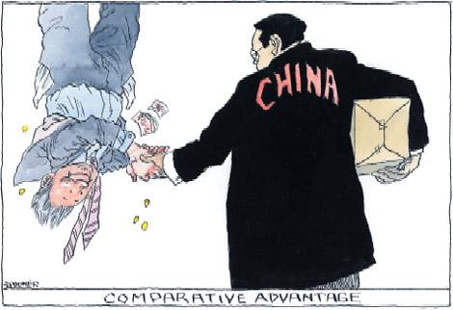
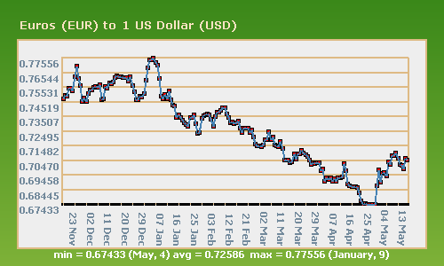
Trade deficit- more imports than exports, leads to a weak currency
US can maintain a high deficit because there is a large demand for US dollars as the int’l currency

Slide 15
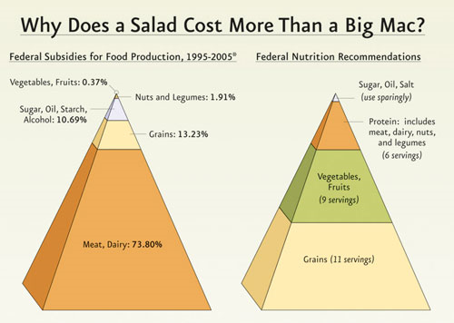
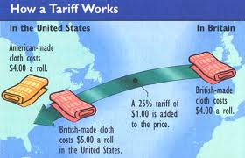
III. Trade Barriers
quota- strict limit on imported goods
tariff- tax on imported goods
subsidies- US gov’t supporting a US industry financially
D. Embargo

Slide 16
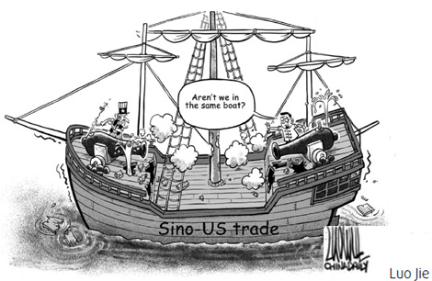
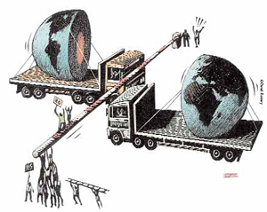
Protectionism-
creating trade barriers to foreign trade in order to make a nation’s goods more competitive
Protectionism may restrict competition, hurt innovation, and lead to trade wars

Slide 17
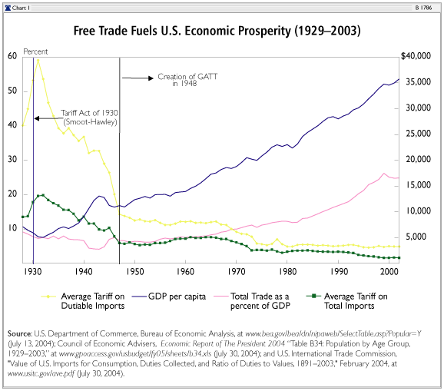
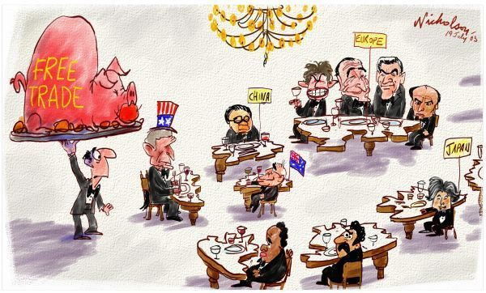
IV. Free Trade
The goal of free trade agreements are to eliminate trade barriers
Advantages- competition, growth among all, int’l specialization

Slide 18
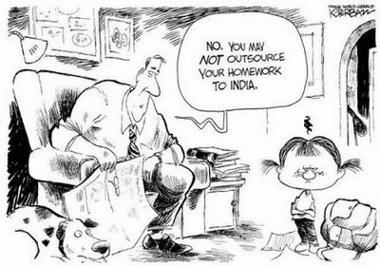
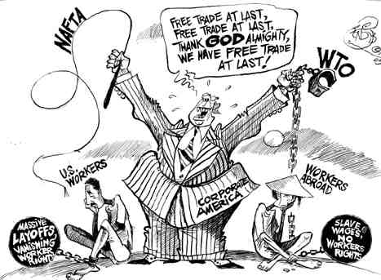
Disadvantages- economic vulnerability, jobs can be outsourced (sent to an external provider)
World Trade Organization (WTO)- negotiates new trade agreements and works to expand world trade

Slide 19
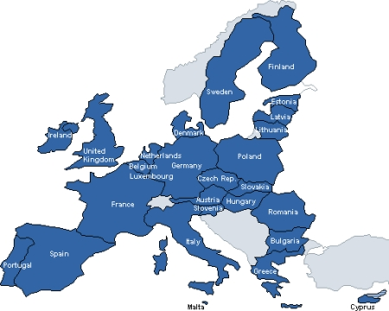
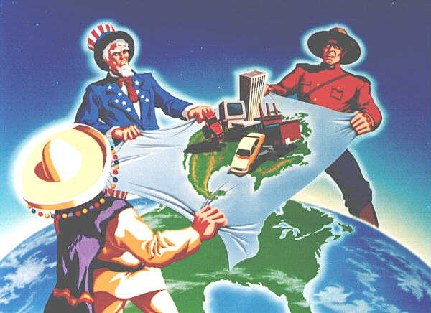
European Union (EU)- European nations have eliminated trade barriers and created a common currency
North American Free Trade Agreement (NAFTA)- goal to eliminate barriers b/w Mexico, Canada, and US

Slide 20
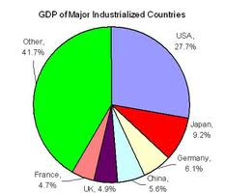
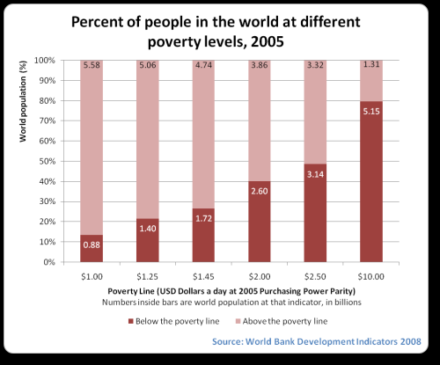
V. Developing Nations
Developing nations have low per capita GDP, poor health, infrastructure, etc
Free trade has helped developing nations out of poverty more than economic aid

Slide 21
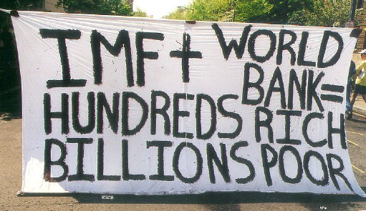
World Bank- lends to developing nations to reduce poverty
International Monetary Fund (IMF)- seeks to stabilize exchange rates and encourage good economic policy

Slide 22
Extra Practice!
Test your knowledge of globalization
Complete the matching

Slide 23
Wow, we must need more time on this…
Inside the Fed & Power of the Purse
Power of the Purse
Tray*
Maddy*
Marcello*
Vlada*
Jackie*
Mike*
Aarya*
Elias*
Jelani*
Jayshawn*
Carson*
Collette
Gabby
Kayla
Molly
Angel
Marcos
Saida
Meredith
Sohan
Felipe
Jourden
Rayna

Slide 24
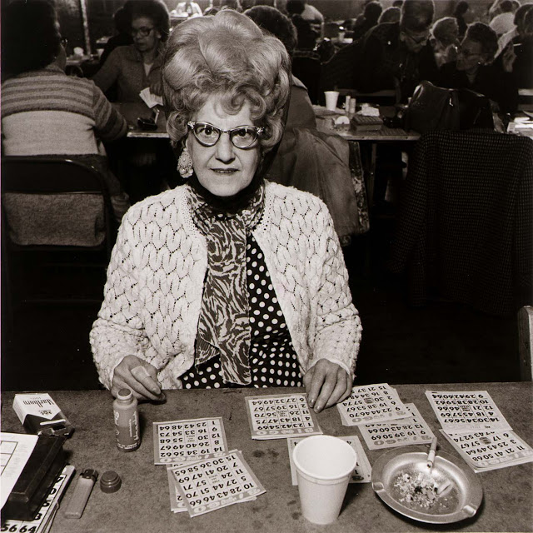
BINGO
Ready for your quiz???

Slide 25
Blueprint Check-in
Take your Final Blueprint out
Continue working on it as Ms. Peach moves around the room to check your progress

Slide 26
Mcdonalds and globalization
http://www.firstladies.org/curriculum/curriculum.aspx?Curriculum=1744

Slide 27
Understanding Your world
Grab a partner
Draw a pair of countries from the bucket
You will use the CIA factbook to research your countries
After you research Use the website “If It Were My Home” to compare your countries to the US
Find this assignment in Google classroom
One person should open the document and share with their partner.
Make sure both your names are on it!

Slide 28
Welcome Knight Time!
Find a seat and settle in
If you want to compete in kahoot sit in the first 3 desks of each row
If you would like to keep working on the Final Blueprint or Unit 7 Blueprint sit in the back three seats of each row

