Slide 1

Sheldon
Grayson
Tai
Sofia
Nicholas
Sophia Z
Venus
Dante
Ja’Marcus
Elias
Jasmine
Asia
Taniah
Cristy
Alejandro
Rachel
Samer
Angelo
Thaia
Dmetri
Kyla
Daniele
Ryan
Zach
Garry
Jessica
Maddie

Slide 2
Megan
Ali
Elijah
Amber
Gabby
Aryan
Jack
Nick F.
Jackie
Sud
Ashleigh
Alex
Michelle
Amelia
Michael
Edison
Avanthi
Nich M.
Carson
Izzy
Eli
Melaina
Gage
Jenna
Anna Marie
Ashley
Kim
Rishi
Maddie
Evie
Charlie

Slide 3
Welcome homeroom!
Ask Ms. Peach Where to sit
You need a chromebook today!
Have you found a Knight time????
Did you fill out the KT google sheet on ms. Peach’s website?

Slide 4
Door Decorating
My Homeroom always places in the door decorating contest
Past Themes:
  Star Wars
  Night Mare Before Christmas
  Stars in Switzerland
Go to my website – msmithpeach.weebly.com
Go to the Homeroom page, scroll down and vote for our theme

Slide 5
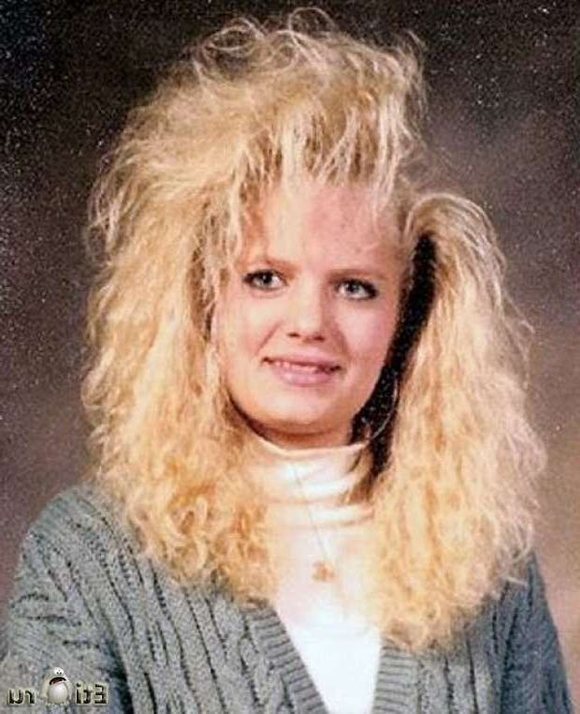

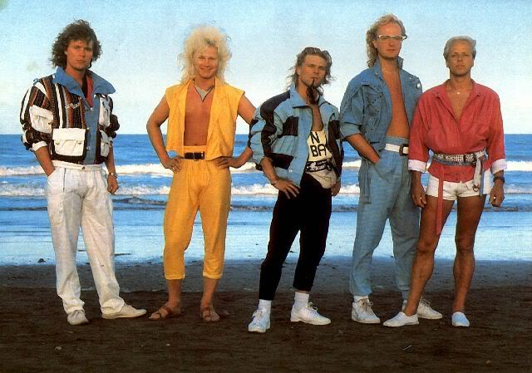
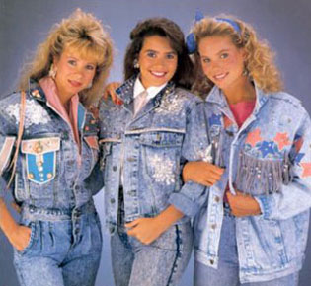
Welcome C&E Students!
Sit with your picks a business partner
Roll Call Question: Would you rather always wear 80s clothes or 80s hairstyles?
Bell Work:
  1. Why is competition important?
  2. Provide an example of Monopolistic Competition. Explain why it is so
  3. Provide an example of Oligopolistic Competition. Explain why it is so.
  4. Provide an example of Perfect/Pure Competition. Explain why it is so.

Slide 6
Reminders
Unit 6 test Tomorrow!
Budget project parts 11-13 due Monday
Recovery
Students of the unit

Slide 7
Competition
Take out your 6.5 notes
With your partner try and determine what type of competition each industry would fall under
After you discuss we will look at our class data from the “What’s Your Favorite” survey to determine what each industry is

Slide 8
Business | 2nd Block | 4th Block
Pizzeria | Sally & Shreya | Ved Ak
Grocery Store | Caitlin & Camryn | Roman & Alex
Fruit Orchard | Harrison | Kathryn & Jack
Frozen Yogurt Shop | Jacob & Sam
Florist | Grace, Anna Gayatri
Butcher |  | Nick & Camden
Music Label | Jack | Spencer & Al
Tattoo Shop | Mack & Ravi | Emme & Liz
Food Truck | Jake & Parker | Mahith & Gokul
Coffee Shop | Nadia & Emily | Hope & Maddie
Bakery | Cathy & Bella | Ananya & Srav
Deli |  | Koushik & Aidan
Clothing Store | Joseph & Gautham | Naomi & Ritcha
Jewelry Store | Jonathan & Will | Ryan & Shawn
Movie Theater | Kaitlin & Sophia | Chris
Barber Shop/ Beauty Parlor | Grant & Mani | Jake & Zach
Candy Store | Taylor & Bash

Slide 9
First You are Producers
Your group has now selected a business. Give it a name!
Now describe the factors of production you will need to create the goods/services (Land, Labor & Capital)
You will then explain how your supply could increase OR decrease using the STONER acronym

Slide 10
Now You are Consumers
Now you will be the consumer of another group’s business
Business will shift Clockwise
You will use the BITER acronym to explain how your demand could increase OR decrease

Slide 11
Graph It!
Look at the back of your sheet
Graph the shifts in supply you came up with
Graph the shifts in demand your consumers came up with

Slide 12
Competition
Take out your 6.5 notes
With your partner try and determine what type of competition each industry would fall under
After you discuss we will look at our class data from the “What’s Your Favorite” survey to determine what each industry is

Slide 13
Welcome C&E Students!
Ask Ms. Peach where to sit
Roll Call Question: Would you rather always wear 80s clothes or 80s hairstyles?
Bell Work:
  1. Why is competition important?
  2. Provide an example of Monopolistic Competition. Explain why it is so
  3. Provide an example of Oligopolistic Competition. Explain why it is so.
  4. Provide an example of Perfect/Pure Competition. Explain why it is so.

Slide 14
Reminders
Unit 6 test Tomorrow!
Budget project parts 11-13 due Monday
Recovery
Students of the unit

Slide 15
Today
You have been grouped based on your quiz performance
I will be stopping by to each group to discuss quiz questions and to assist you on the following items
  Circular Flow
  Shifts in Supply & Demand
  Blueprint
  Budget project

Slide 16
Trashsketball Unit 6

Slide 17
6.1- Intro to Economics

Slide 18
Question
This is the study of how we seek to satisfy needs and wants with limited resources

Slide 19
Answer
Economics

Slide 20
Question
Explain the difference between needs and wants

Slide 21
Answer
Needs- necessary for survival
Wants- desire not necessary for survival

Slide 22
Question
this is the driving force of economics. It means we have limited quantities of resources and unlimited wants

Slide 23
Answer
Scarcity

Slide 24
Question
What is consumer sovereignty

Slide 25
Answer
Power of consumers to decide what gets produced

Slide 26
Question
Give an example of immediate gratification

Slide 27
Answer
Ask Ms. Smith

Slide 28
Question
What are the 4 factors of production?

Slide 29
Answer
Land, labor, capital and entrepreneurship

Slide 30
Question
What is the difference between white and blue-collar workers?

Slide 31
Answer
White Collar – high skilled office worker
Blue Collar – lower skilled/ manual labor

Slide 32
Question
How is physical capital different from human capital?

Slide 33
Answer
Physical – buildings, tools, machines
Human – knowledge and skills you gain through education and experience

Slide 34
Question
What is a trade-off?

Slide 35
Answer
The process of giving up one desire in order to satisfy another desire

Slide 36
Question
What is an opportunity cost?

Slide 37
Answer
The value of what you gave up in the trade-off

Slide 38
6.2 – Labor Unions

Slide 39
Question
Why do Labor Unions exist?

Slide 40
Answer
To negotiate better pay, benefits and working conditions from employers

Slide 41
Question
Gave workers the right to organize, minimum wage, overtime pay and no child labor

Slide 42
Answer
New Deal

Slide 43
Question
These ban mandatory union membership

Slide 44
Answer
Right-to-work laws

Slide 45
Question
when union and company representatives meet periodically to negotiate new labor contracts

Slide 46
Answer
collective bargaining

Slide 47
Question
This person was the author of the Jungle

Slide 48
Answer
Upton Sinclair

Slide 49
Question
What are 2 tools an employer can use against its workers?

Slide 50
Answer
Lockout
Injunction

Slide 51
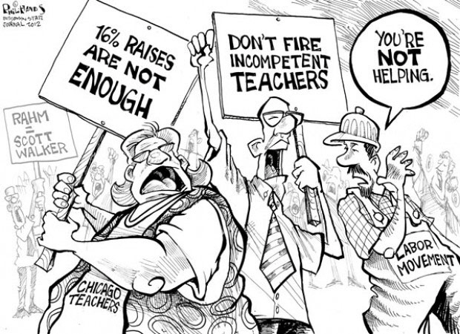
Question
Analyze what is happening in this cartoon

Slide 52
Answer
Chicago teachers on strike, demanding better pay

Slide 53
6.2 - Circular Flow of Income

Slide 54
Question
In the circular flow of income who makes the goods and services?

Slide 55
Answer
Firms (businesses/producers)

Slide 56
Question
Where in the circular flow of income can you find land, labor, capital and entrepreneurship?

Slide 57
Answer
Factor Market

Slide 58
Question
Why can’t the US truly be called a Free-Market Economy?

Slide 59
Answer
We have some government intervention in our economy

Slide 60
Question
What exchange occurs in the factor Market?

Slide 61
Answer
Income is exchanged for Factors of production

Slide 62
Question
What is a government subsidy?

Slide 63
Answer
Financial capital ($) from the government going to a business to aid in production

Slide 64
Question
What do household receive from the government in exchange for paying taxes?

Slide 65
Question
Entitlements & Services

Slide 66
6.4 –Supply & Demand

Slide 67
Question
This is the desire to own something and the ability to pay for it

Slide 68
Answer
Demand

Slide 69
Question
This occurs when demand exceeds supply, it usually means that the price is too low

Slide 70
Answer
Shortage

Slide 71
Question
What is the law of demand?

Slide 72
Answer
When a good’s price is lower, consumers will buy more of it. When the price is higher, consumers will buy less of it.

Slide 73
Question
This terms refers to the amount of goods available

Slide 74
Answer
Supply

Slide 75
Question
What are the 5 Demand Shifters?

Slide 76
Answer
Buyers (# of)
Income changes
Tastes changing
Expectations of the consumer
Related goods
  Substitutes
  Compliments

Slide 77
Question
The higher the price, the larger the quantity produced. As the price falls, quantity of supply falls.

Slide 78
Answer
Law of Supply

Slide 79
Question
When quantity demand and quantity supplied are at the same price then they reach an

Slide 80
Answer
Equilibrium

Slide 81
Question
This indicates that a good’s price is too high, supply exceeds demand

Slide 82
Answer
Surplus

Slide 83
Question
Give an example of substitute goods

Slide 84
Answer
Ask Ms. Smith

Slide 85
Question
Give an example of complimentary goods

Slide 86
Answer
Ask Ms. Smith

Slide 87
Question
What are the 6 Supply Shifters?

Slide 88
Answer
Subsidies/taxes
Technology
Other Goods
Number of buyers
Expectations of the Producer
Resource Costs

Slide 89
Question
What are subsidies?

Slide 90
Answer
government money given to help production

Slide 91
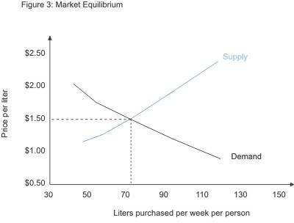
Question
What would occur if Coke decided to lower the price of a liter of soda to $1?

Slide 92
Answer
A Shortage of coke

Slide 93
Question
What would occur on a graph (Depicting coke sales) is suddenly the cost of Pepsi rises?

Slide 94
Answer
The demand of coke will increase – change in price of substitutes

Slide 95
Question
What would occur on the graph (Coke Sales) if suddenly there is a study published that claims drinking Coke shorten your lifespan?

Slide 96
Answer
Demand for Coke decreases – consumer expectations

Slide 97
Question
What would occur on the graph if the government suddenly gave coke a subsidy?

Slide 98
Question
Supply would increase – government intervention

Slide 99
Question
In the circular flow of income who provides the labor resources need to make the goods?

Slide 100
Answer
Households (consumers)

Slide 101
Questions
What forces establish prices and what gets produced and bought?

Slide 102
Answer
Supply and Demand

Slide 103
Question
Explain what this cartoon is illustrating regarding supply and demand

Slide 104
Answer
Prices are established by supply and demand. When a good is scarce demand is high and people are willing to pay more for it

Slide 105
6.5 – Competition

Slide 106
Question
This terms refers to when all the market share and influence is controlled by one firm – this is the absence of competition

Slide 107
Question
Monopoly

Slide 108
Question
What are 2 of the 3 reasons why competition is important?

Slide 109
Answer
Lowers price
Improves quality
Improves efficiency of the market

Slide 110
Question
Explain what Perfect Competition is.

Slide 111
Answer
all competitive firms have the same market share and influence and offer the same product with little to no control over prices

Slide 112
Question
Explain what oligopolistic competition is

Slide 113
Answer
only a few number of firms have market share and thus control and dominate products and prices

Slide 114
Question
Explain what monopolistic competition is

Slide 115
Answer
all competitive firms have similar market share yet offer slightly differentiated products at varying prices

Slide 116
Question
This is the struggle between various producers to win the largest part of a market

Slide 117
Answer
Competition

Slide 118
Question
In what type of competition will the consumer use brand loyalty to decide which product to purchase

Slide 119
Answer
Perfect Competition

